Slide 1
INDIAN ECONOMY ON THE EVE OF
INDEPENDENCE

Slide 2
Population situation also showed backwardness.
(i) Overall literacy rate was 16%. Female literacy rate was seven percent.
(ii) Death rate was very high due to inadequate public health facilities.
(iii) Infant Mortality Rate was nearly 218 per thousand.
(iii) Life expectancy at birth was very low (44 years)
(iv) Large section of the population was under extreme poverty.

Slide 3
THE YEAR OF GREAT DIVIDE
1921 is considered as the year of Great Divide. Before 1921, the population of India was fluctuating, increasing in one census and decreasing in the other. After 1921, the population never decreased. It showed continuous increase.

Slide 4
OCCUPATIONAL STRUCTURE
Occupational structure refers to distribution of working population across primary, secondary and tertiary sectors of the economy.
(i) 70 to 75 percent of Indian working population was engaged in primary sector.
(ii) Less than 10% of the workers were in the secondary sector.
(iii) Tertiary sector employed nearly 15 to 20% of the workers.

Slide 5
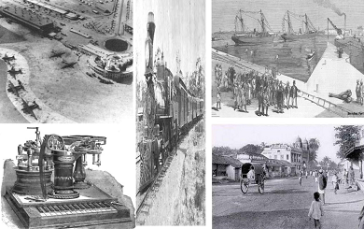
INFRASTRUCTURE

Slide 6
The British government took same steps to develop infrastructural facilities in India.
(i) Railway was introduced in India. Railway helped the English to transport their goods to the interior parts of India. It also helped in the quick movement of their armed forces.
(ii) A number of roads were constructed. Roads also helped them to transport their goods.
(iii) Post and Telegraphs were developed. Communication facilities were needed for the easy administration of India.

Slide 7
(iv)Seaports were developed to handle the export of raw materials to Britain and import of finished goods to India.
(v) The Inland waterway was built along the coast of Orissa by spending huge amount of money. But it was uneconomic. It could not compete with the Railways.

Slide 8
INTRODUCTION OF RAILWAYS Railways were introduced in 1850 in India.
POSITIVE EFFECTS OF RAILWAYS ON INDIA:
Railways helped people to travel long distances. Thus it promoted National Integration.
Railways promoted Commercial farming.
Volume of India’s export trade increased.
Large number of people got jobs in Railways.

Slide 9
NEGATIVE EFFECTS OF RAILWAYS ON INDIA:
Railways helped British to collect raw materials from interior parts of India and sell finished goods even in remote areas. This resulted in the decline of Indian Handicrafts industries.
Introduction of Railways promoted Commercial Farming. The villages lost their self sufficiency.
Railways helped British to move their army quickly and suppress National Movements.

